Slide 1


RAMAKRISNA MISSION VIDYAMANDIRA
SARA - Seat Allocation with Rectangular Array

Slide 2

The Allocation Challenge
Seating students for examinations remains one of the most complex operational challenges in academic administration. Manually, this allocation is time-consuming, prone to human error, and creates inefficiencies across examination logistics.

Slide 3
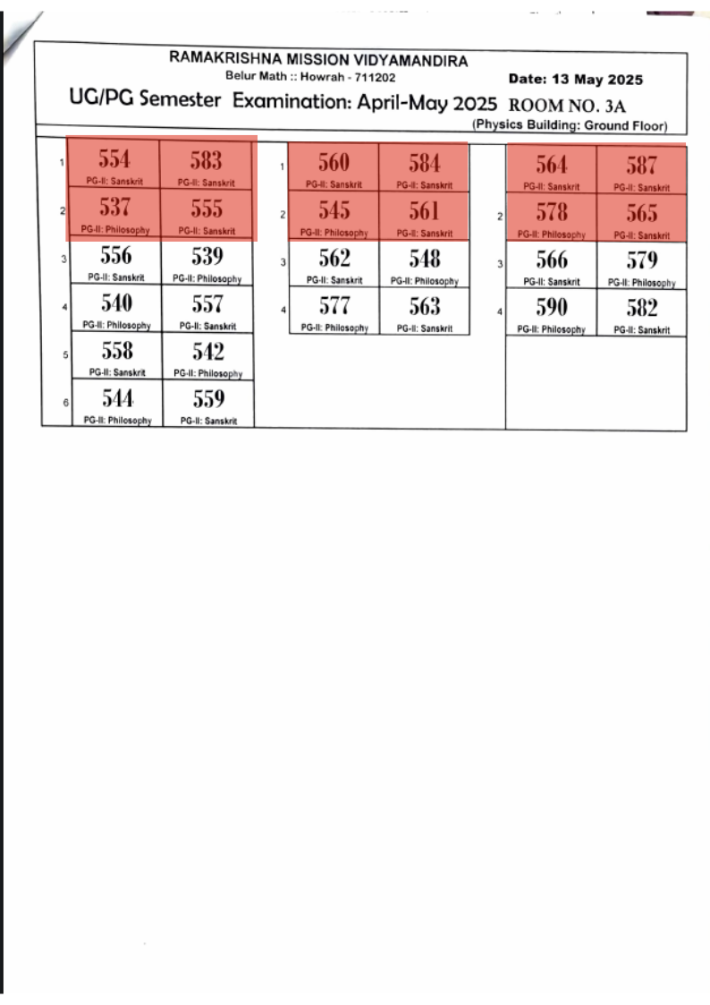

Slide 4
Why This Matters
Redundant Exam System .
Inefficient.
It is a Matter of headache.

Slide 5

Introducing
SARA
Intelligent. Efficient. Reliable.

Slide 6
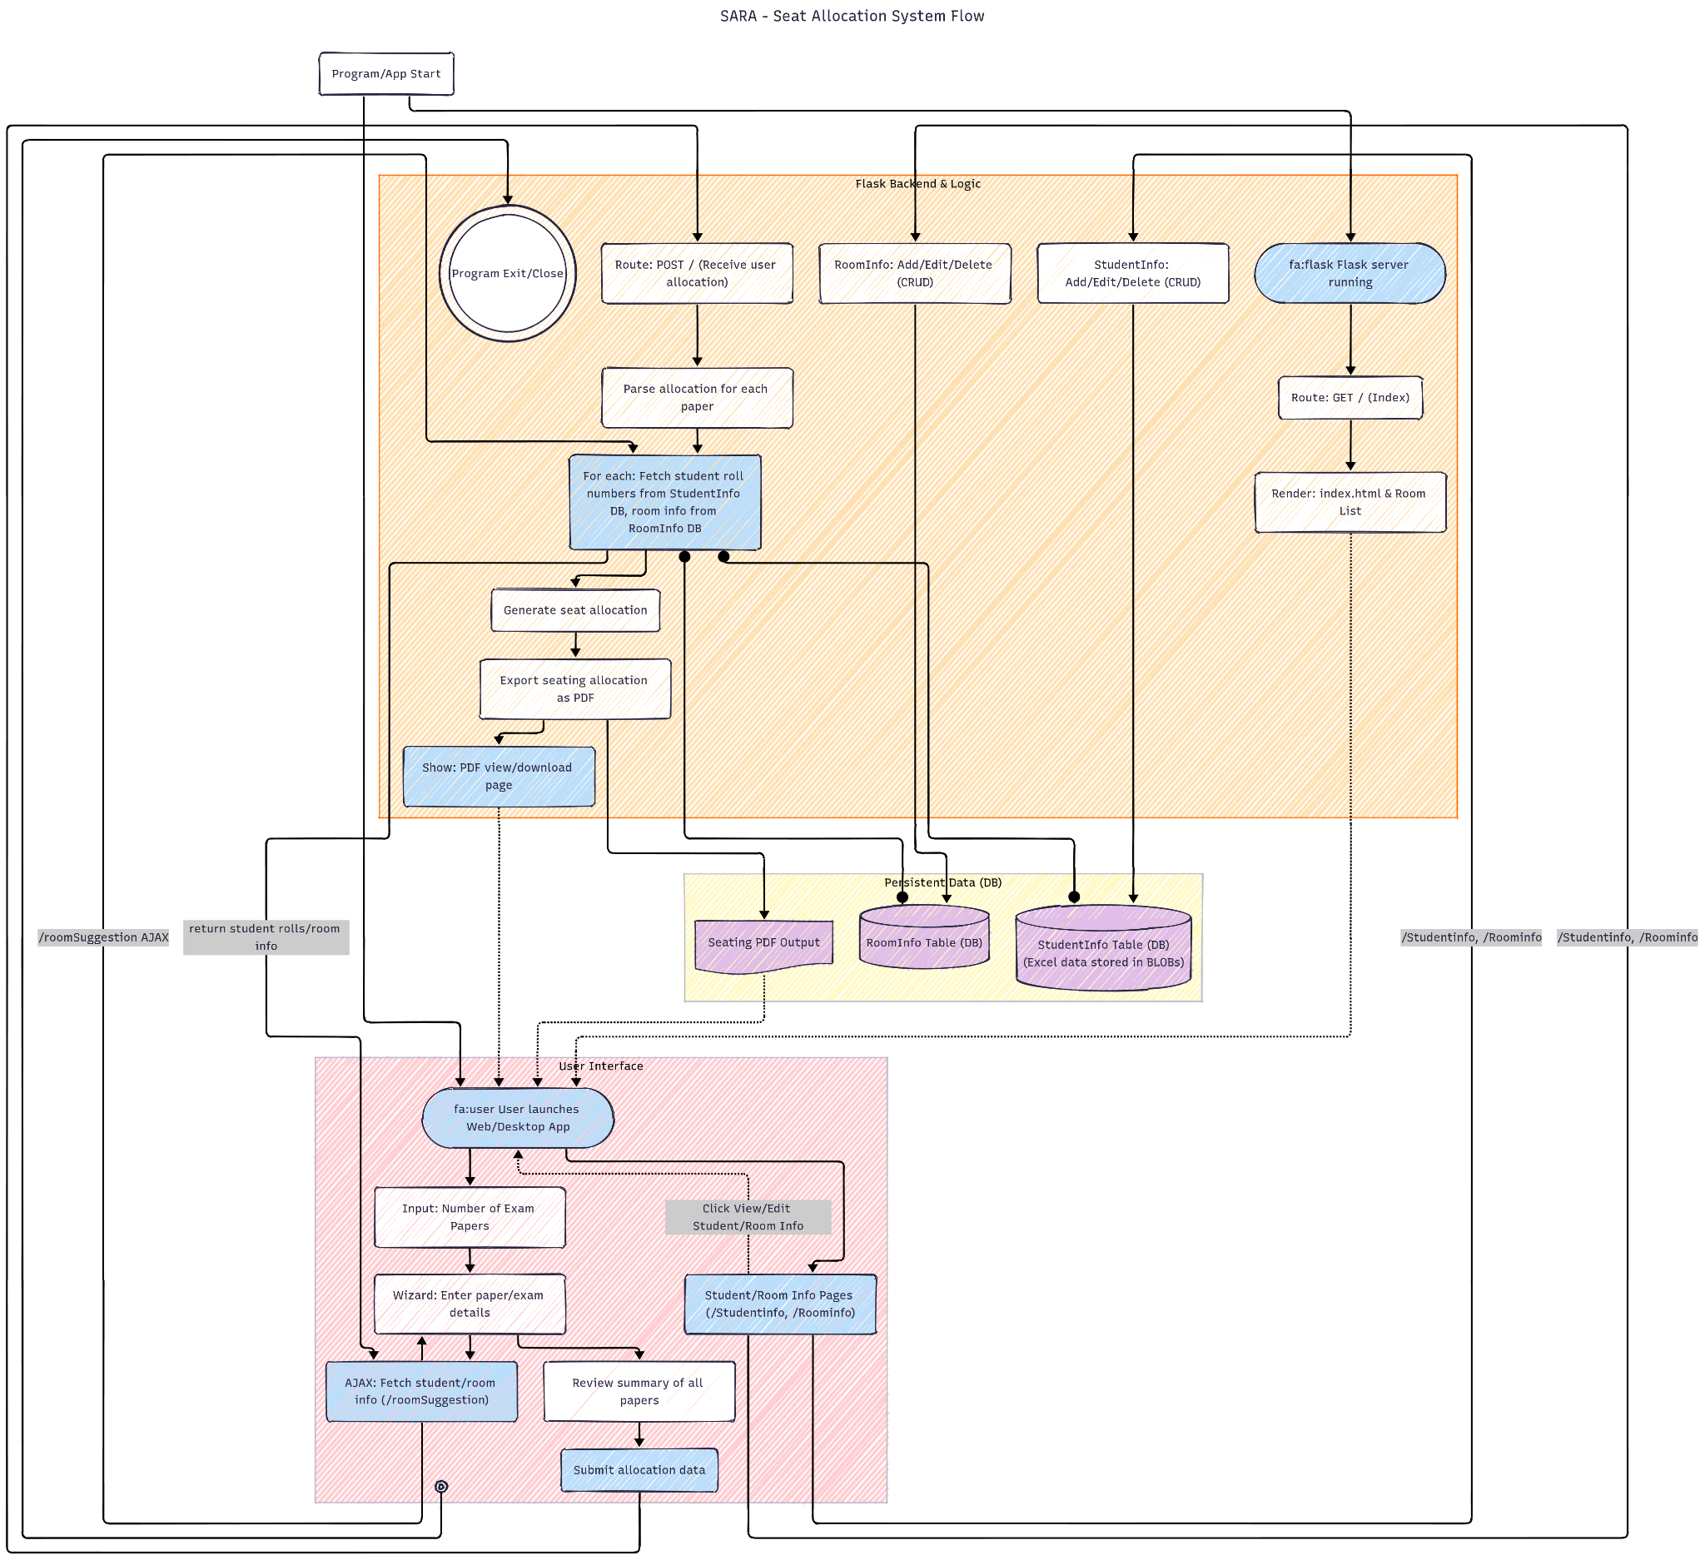
How It Works
Data Input
Constraint analysis with client side scripting
Allocating seat in a rectangular 2D array
Verification & Export

Slide 7
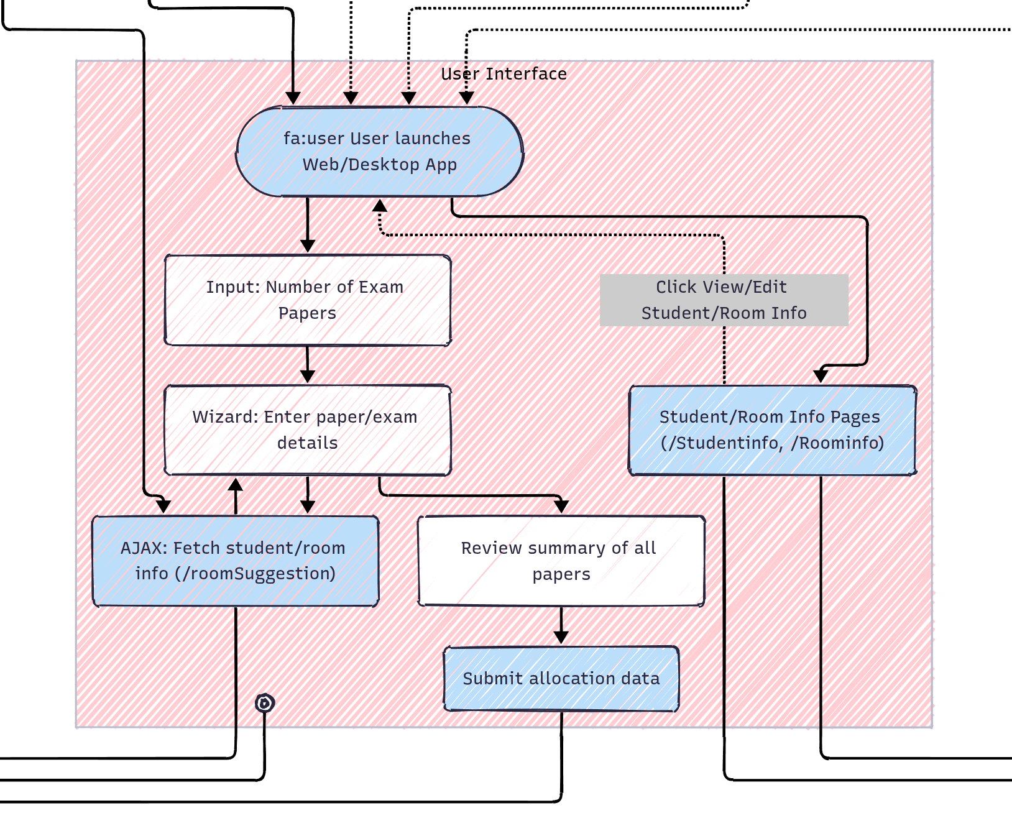
FRONTEND
Architecture
provides the way to database
takes input for seat allocation
verify the logical validity of
input data
sends the data to the BACKEND

Slide 8
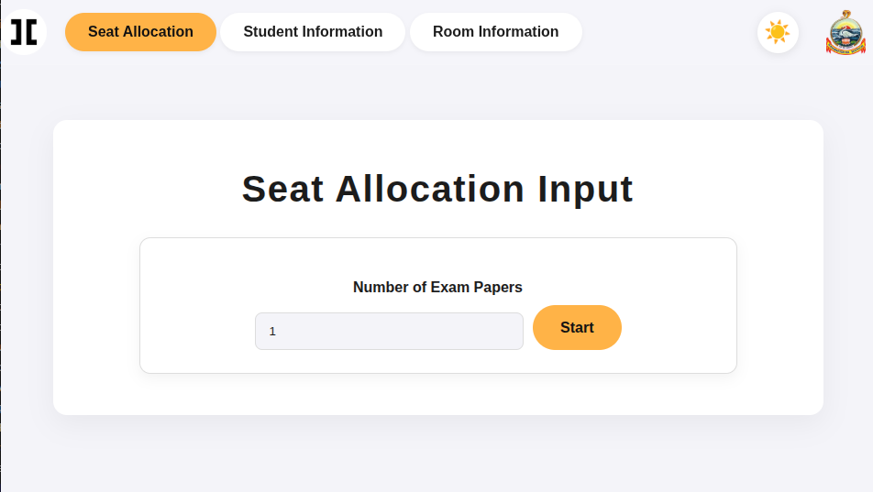

Slide 9
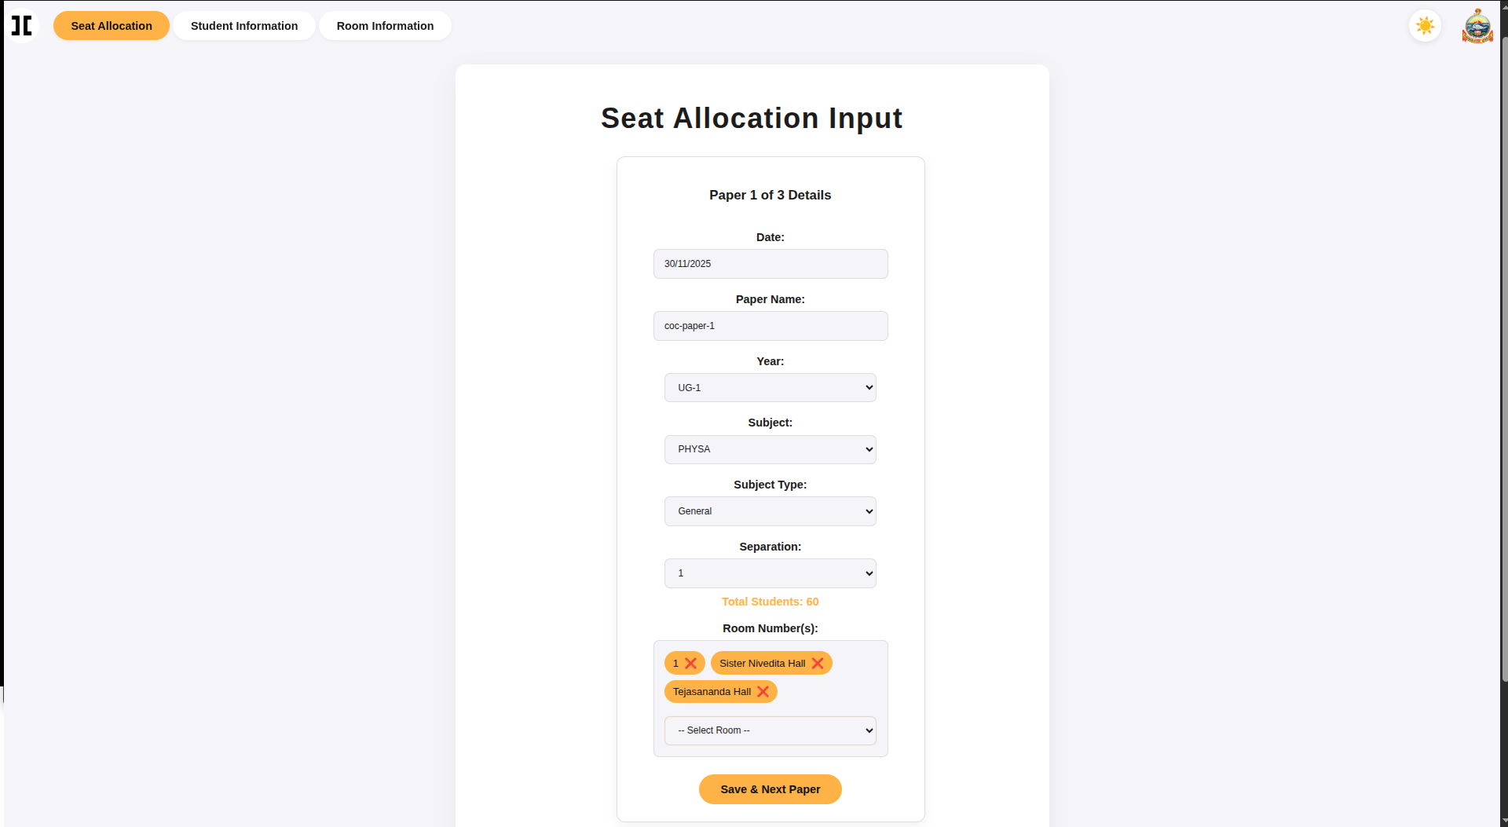

Slide 10
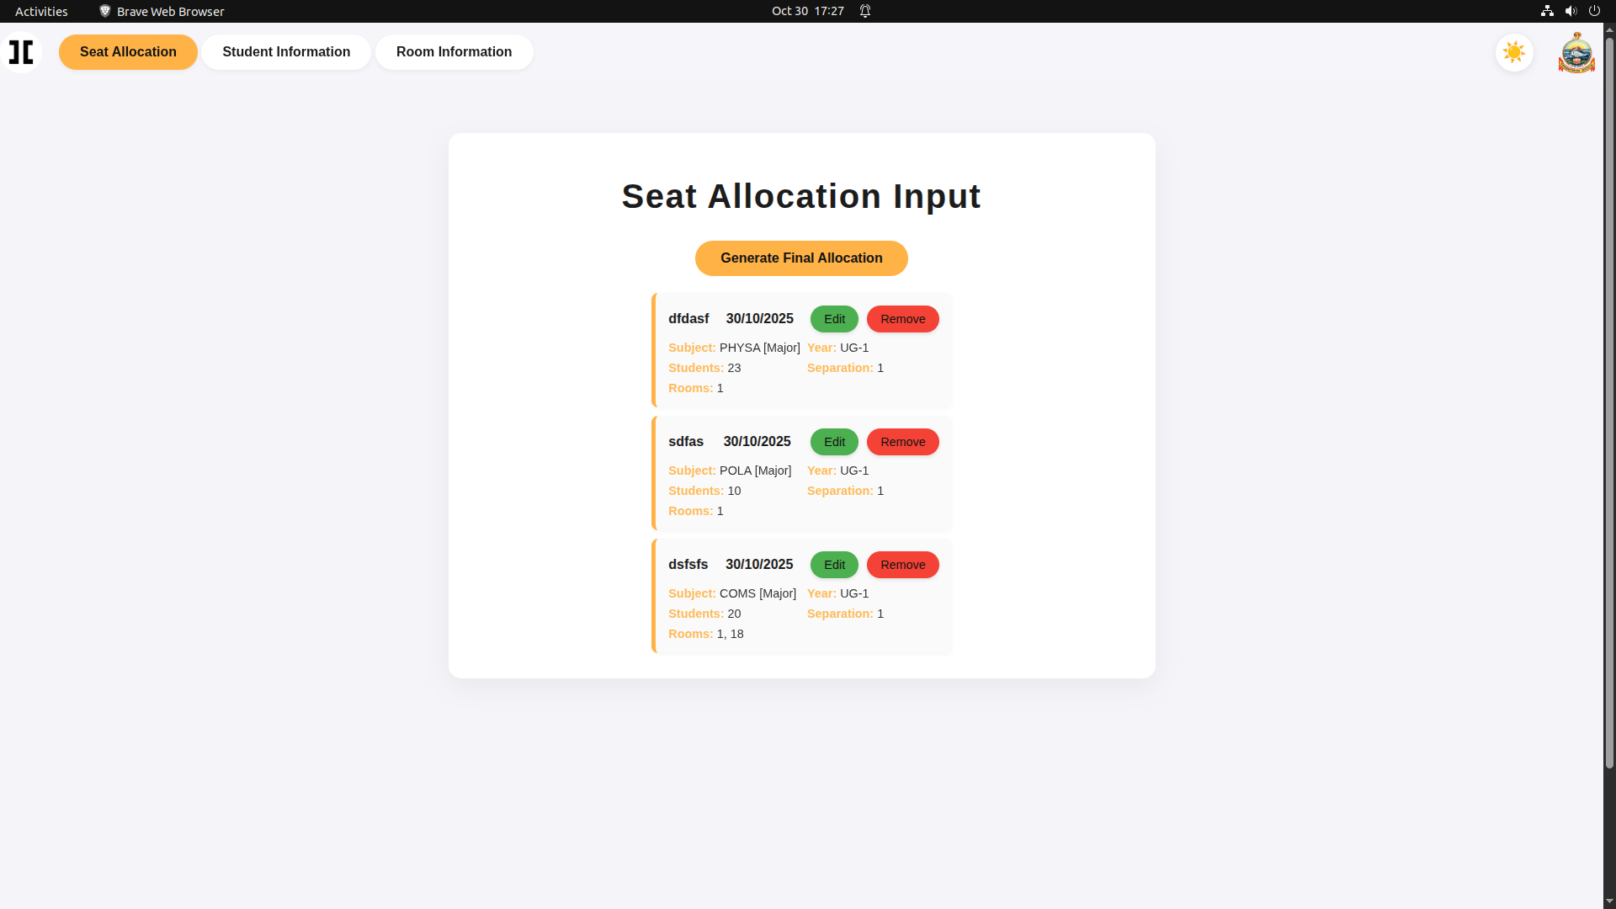

Slide 11
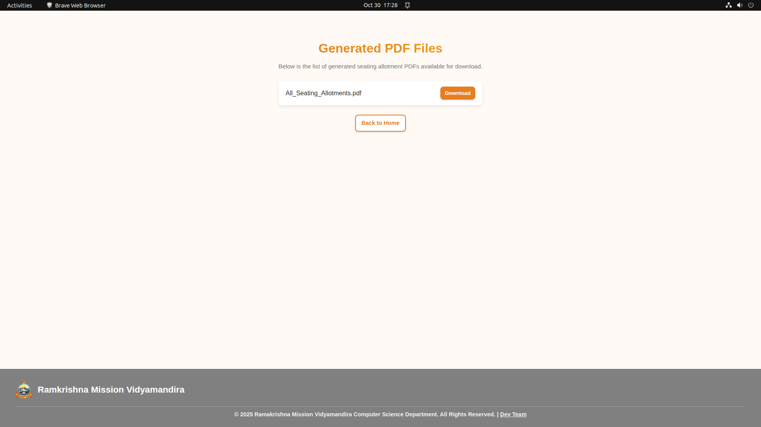

Slide 12
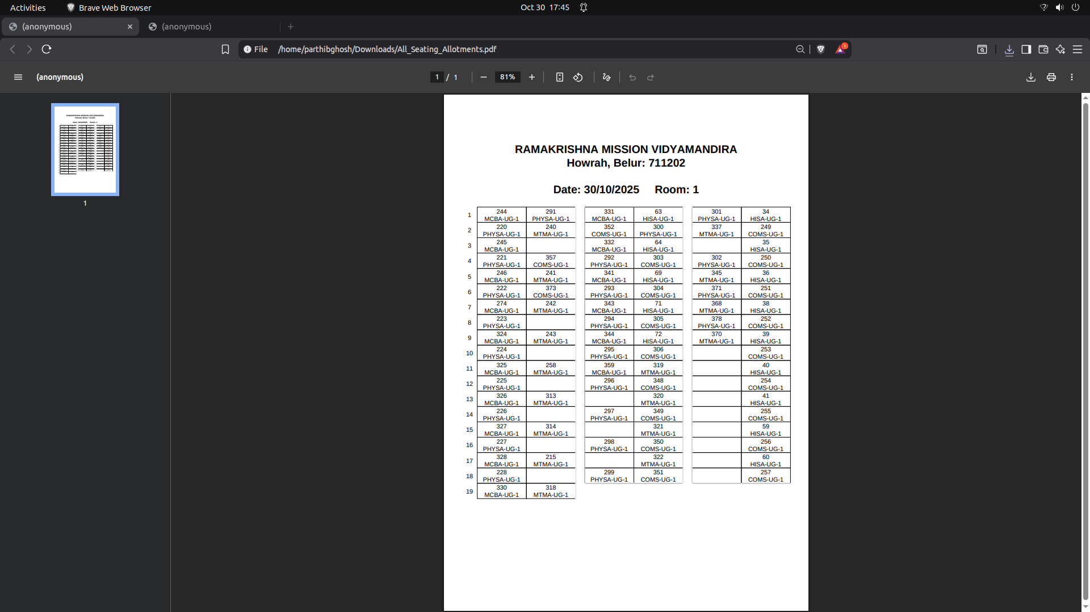

Slide 13
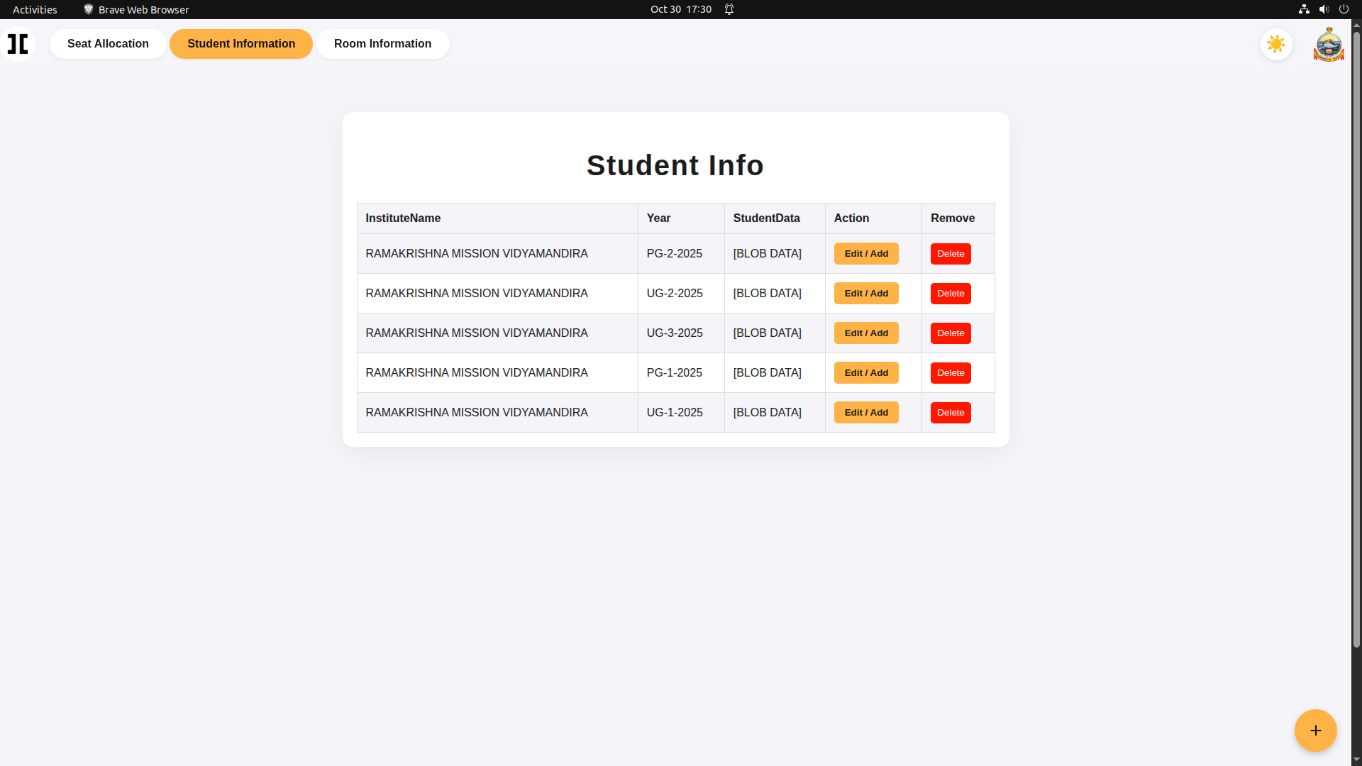

Slide 14
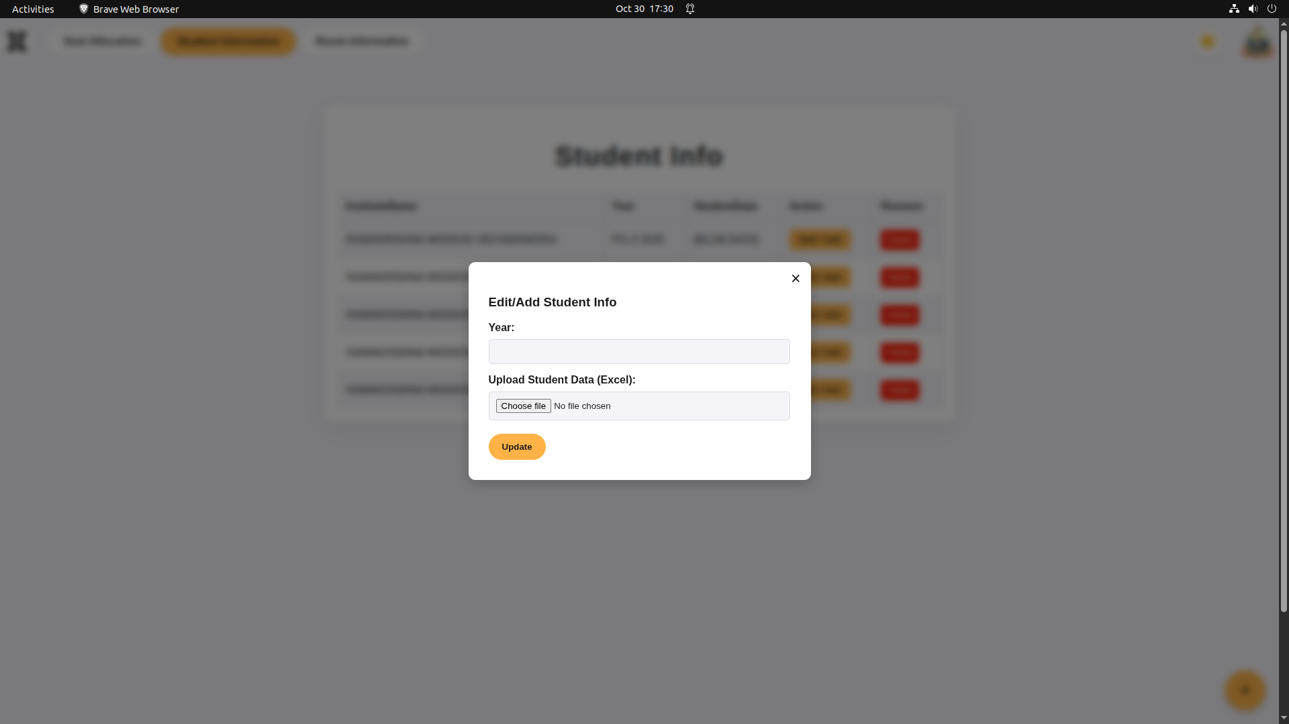

Slide 15
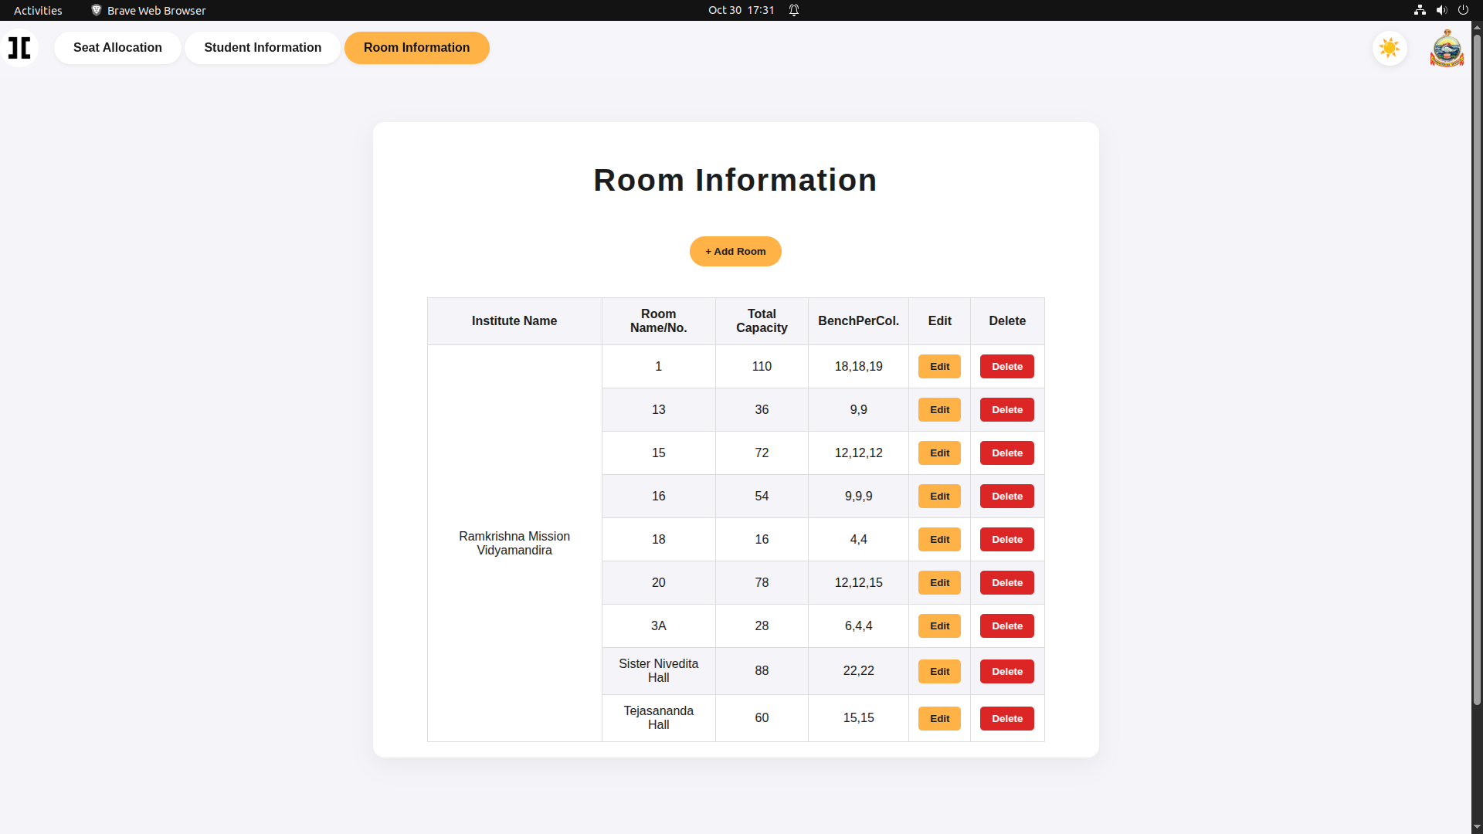

Slide 16
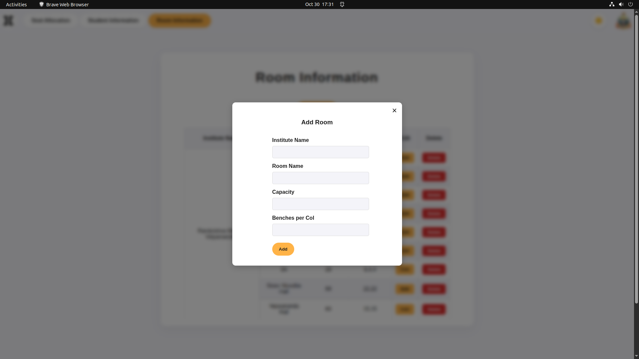

Slide 17


Slide 18
BACKEND
Architecture
After getting all inputs, it Allocates seat
convert the data into pdf
provide the pdf
Also changes the database table

Slide 19
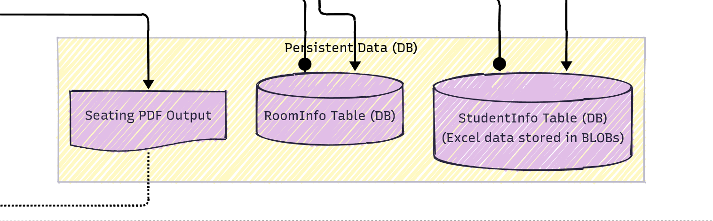
DATABASE

Slide 20

Future Scope
Introducing other entities
Increasing security and encryption
Dynamic Subject according to database

Slide 21
Tools
Visual Studio Code
LLMs
flask: https://flask.palletsprojects.com/en/stable/quickstart/#a-minimal-application
Javascript,HTML, CSS, MYSQL

Slide 22
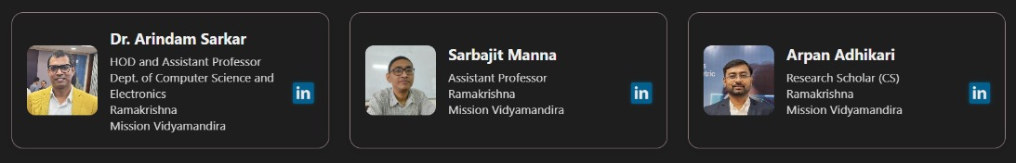
Acknowledgement

Slide 23
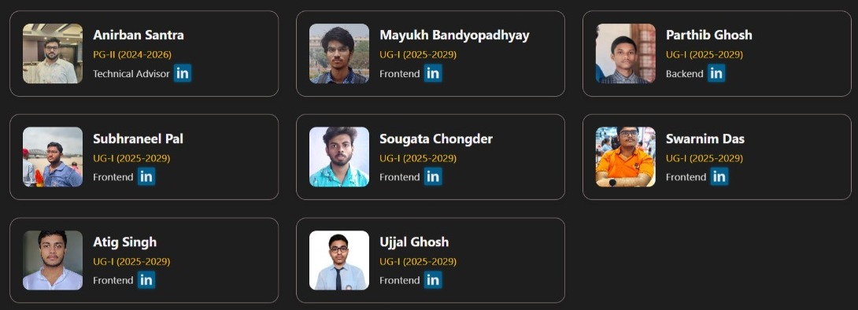
Our Team

Slide 24

Thank You

